Slide 1
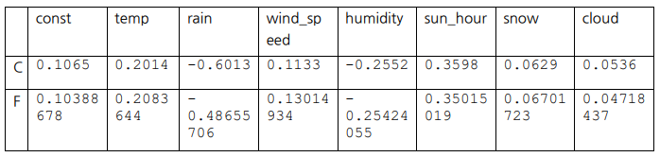
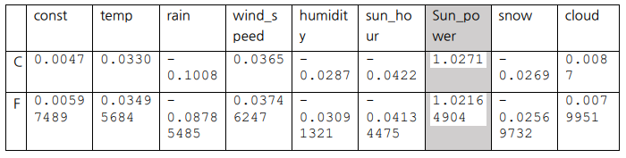
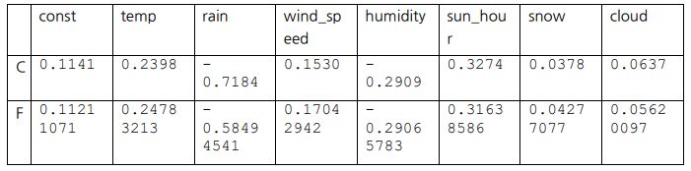
매개변수
Sun_power
독립변수
종속변수
Temp
Rain
Wind_speed
Humidity
Sun_hour
Snow
Cloud
Solar_power

Slide 2
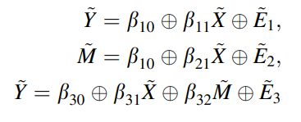
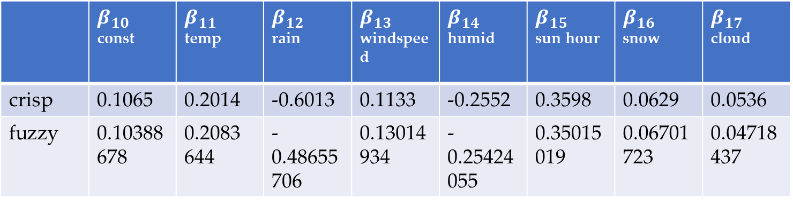
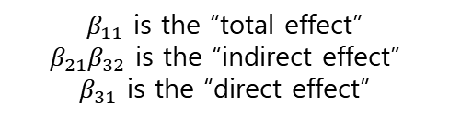
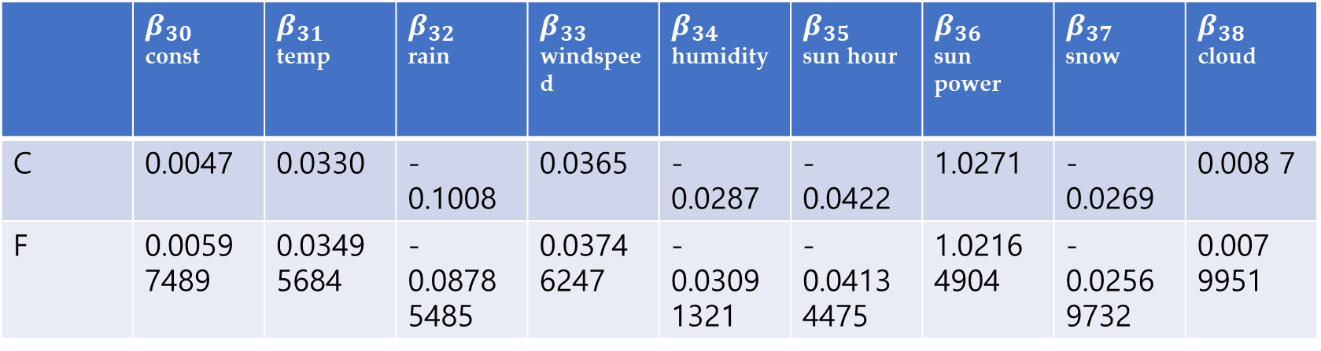
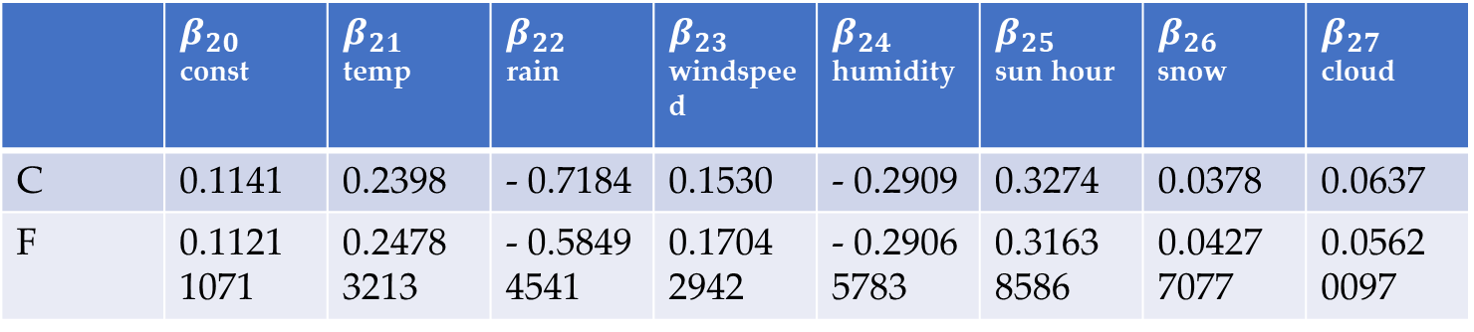
 | $β_{10}$ const | $β_{11}$ temp | $β_{12}$ rain | $β_{13}$ windspeed | $β_{14}$ humid | $β_{15}$ sun hour | $β_{16}$ snow | $β_{17}$ cloud
crisp | 0.1065 | 0.2014 | -0.6013 | 0.1133 | -0.2552 | 0.3598 | 0.0629 | 0.0536
fuzzy | 0.10388678 | 0.2083 644 | - 0.48655 706 | 0.13014 934 | - 0.25424 055 | 0.35015 019 | 0.06701 723 | 0.04718 437
$$β_{11} \text{is} \text{the}\text{ “}\text{total} \text{effect}\text{”}$$
$$β_{21}β_{32} \text{is} \text{the}\text{ “}\text{indirect} \text{effect}\text{”}$$
$$β_{31} \text{is} \text{the}\text{ “}\text{direct} \text{effect}\text{”}$$
Total: 0.1659547
Indirect:
direct
 | $β_{20}$ const | $β_{21}$ temp | $β_{22}$ rain | $β_{23}$ windspeed | $β_{24}$ humidity | $β_{25}$ sun hour | $β_{26}$ snow | $β_{27}$ cloud
C | 0.1141 | 0.2398 | - 0.7184 | 0.1530 | - 0.2909 | 0.3274 | 0.0378 | 0.0637
F | 0.1121 1071 | 0.2478 3213 | - 0.5849 4541 | 0.1704 2942 | - 0.2906 5783 | 0.3163 8586 | 0.0427 7077 | 0.0562 0097
 | $β_{30}$ const | $β_{31}$ temp | $β_{32}$ rain | $β_{33}$ windspeed | $β_{34}$ humidity | $β_{35}$ sun hour | $β_{36}$ sun power | $β_{37}$ snow | $β_{38}$ cloud
C | 0.0047 | 0.0330 | - 0.1008 | 0.0365 | - 0.0287 | - 0.0422 | 1.0271 | - 0.0269 | 0.008 7
F | 0.0059 7489 | 0.0349 5684 | - 0.0878 5485 | 0.0374 6247 | - 0.0309 1321 | - 0.0413 4475 | 1.0216 4904 | - 0.0256 9732 | 0.007 9951

Slide 3
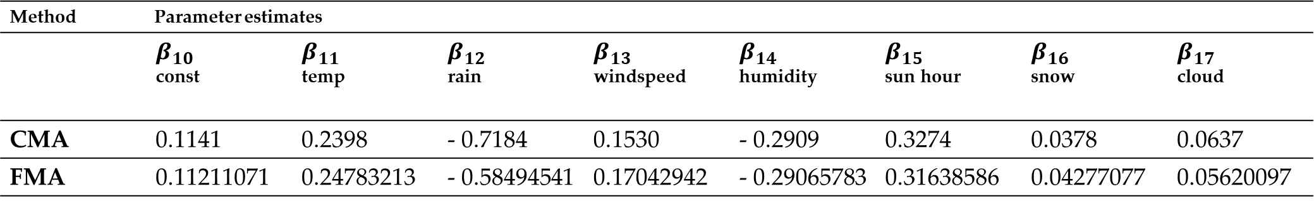
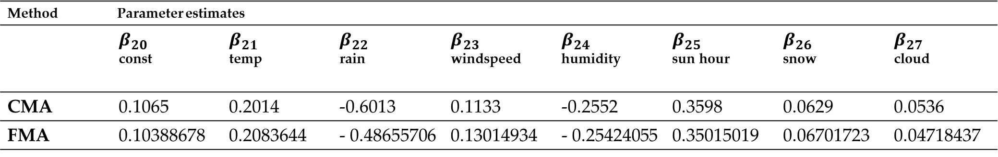
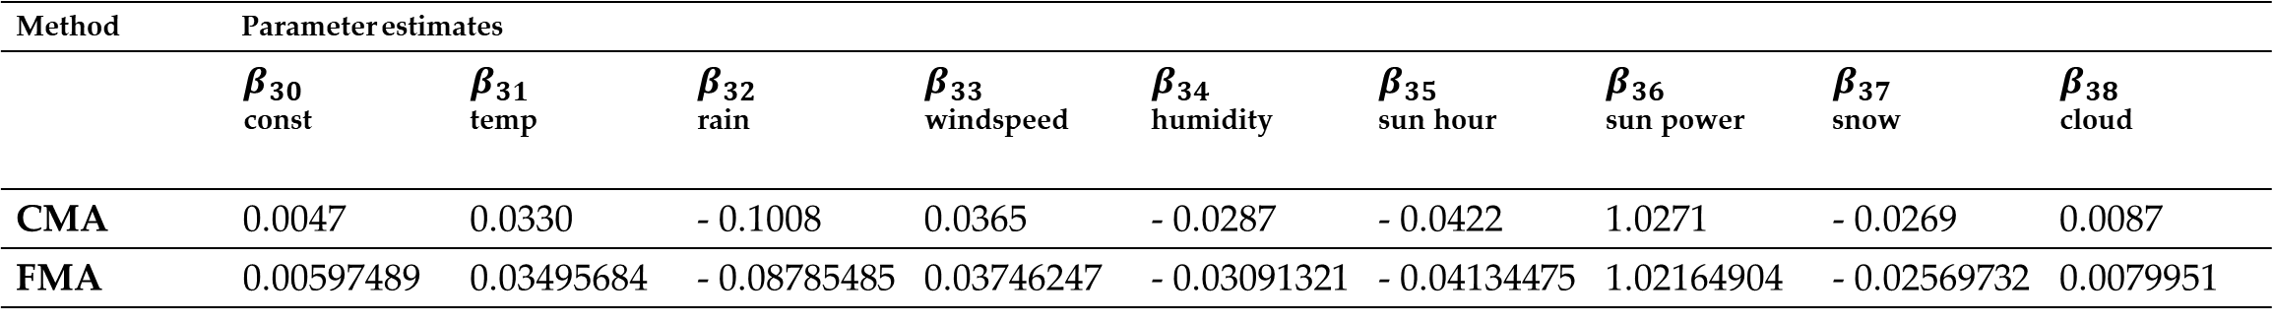
Method Parameter estimates
 | $β_{10}$ const | $β_{11}$ temp | $β_{12}$ rain | $β_{13}$ windspeed | $β_{14}$ humidity | $β_{15}$ sun hour | $β_{16}$ snow | $β_{17}$ cloud
CMA | 0.1141 | 0.2398 | - 0.7184 | 0.1530 | - 0.2909 | 0.3274 | 0.0378 | 0.0637
FMA | 0.11211071 | 0.24783213 | - 0.58494541 | 0.17042942 | - 0.29065783 | 0.31638586 | 0.04277077 | 0.05620097
Method Parameter estimates | Parameter estimates
 | $β_{20}$ const | $β_{21}$ temp | $β_{22}$ rain | $β_{23}$ windspeed | $β_{24}$ humidity | $β_{25}$ sun hour | $β_{26}$ snow | $β_{27}$ cloud
CMA | 0.1065 | 0.2014 | -0.6013 | 0.1133 | -0.2552 | 0.3598 | 0.0629 | 0.0536
FMA | 0.10388678 | 0.2083644 | - 0.48655706 | 0.13014934 | - 0.25424055 | 0.35015019 | 0.06701723 | 0.04718437
Method Parameter estimates
 | $β_{30}$ const | $β_{31}$ temp | $β_{32}$ rain | $β_{33}$ windspeed | $β_{34}$ humidity | $β_{35}$ sun hour | $β_{36}$ sun power | $β_{37}$ snow | $β_{38}$ cloud
CMA | 0.0047 | 0.0330 | - 0.1008 | 0.0365 | - 0.0287 | - 0.0422 | 1.0271 | - 0.0269 | 0.0087
FMA | 0.00597489 | 0.03495684 | - 0.08785485 | 0.03746247 | - 0.03091321 | - 0.04134475 | 1.02164904 | - 0.02569732 | 0.0079951

Slide 4
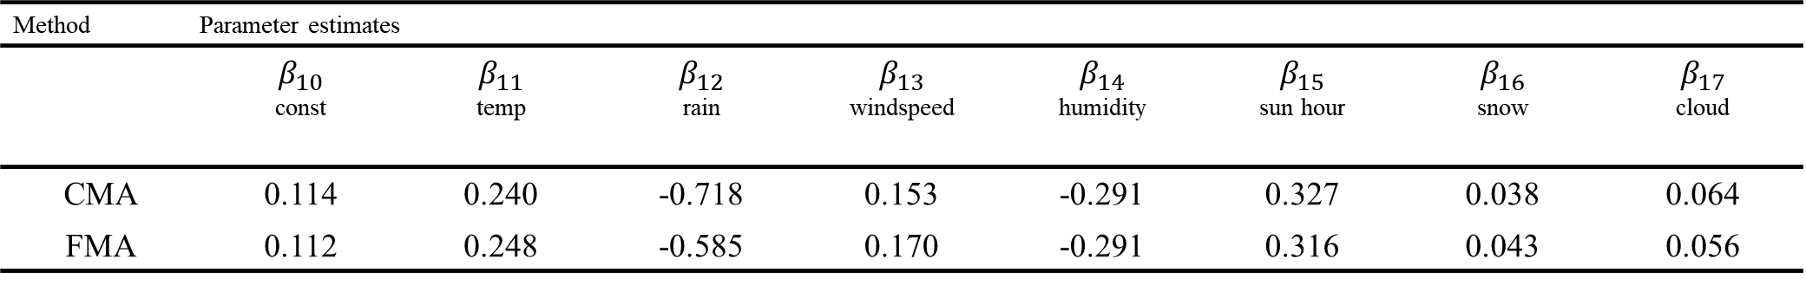
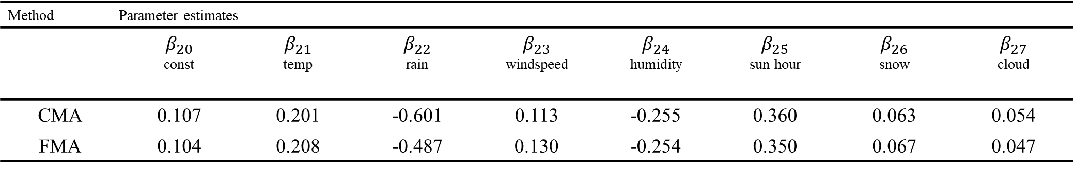
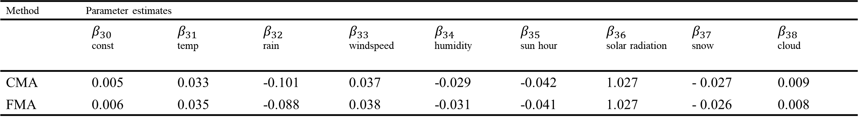
Method Parameter estimates
 | $β_{10}$ const | $β_{11}$ temp | $β_{12}$ rain | $β_{13}$ windspeed | $β_{14}$ humidity | $β_{15}$ sun hour | $β_{16}$ snow | $β_{17}$ cloud
CMA | 0.114 | 0.240 | -0.718 | 0.153 | -0.291 | 0.327 | 0.038 | 0.064
FMA | 0.112 | 0.248 | -0.585 | 0.170 | -0.291 | 0.316 | 0.043 | 0.056
Method Parameter estimates | Parameter estimates
 | $β_{20}$ const | $β_{21}$ temp | $β_{22}$ rain | $β_{23}$ windspeed | $β_{24}$ humidity | $β_{25}$ sun hour | $β_{26}$ snow | $β_{27}$ cloud
CMA | 0.107 | 0.201 | -0.601 | 0.113 | -0.255 | 0.360 | 0.063 | 0.054
FMA | 0.104 | 0.208 | -0.487 | 0.130 | -0.254 | 0.350 | 0.067 | 0.047
Method Parameter estimates
 | $β_{30}$ const | $β_{31}$ temp | $β_{32}$ rain | $β_{33}$ windspeed | $β_{34}$ humidity | $β_{35}$ sun hour | $β_{36}$ solar radiation | $β_{37}$ snow | $β_{38}$ cloud
CMA | 0.005 | 0.033 | -0.101 | 0.037 | -0.029 | -0.042 | 1.027 | - 0.027 | 0.009
FMA | 0.006 | 0.035 | -0.088 | 0.038 | -0.031 | -0.041 | 1.027 | - 0.026 | 0.008

Slide 5
Method Effect
 | Total effect | Direct effect | Indirect effect
CMA | 0.240 | 0.033 | 0.207
FMA | 0.248 | 0.035 | 0.213
Method Effect
 | Total effect | Direct effect | Indirect effect
CMA | -0.718 | -0.101 | -0.617
FMA | -0.585 | -0.088 | -0.497
Method Effect
 | Total effect | Direct effect | Indirect effect
CMA | 0.153 | 0.037 | 0.116
FMA | 0.170 | 0.038 | 0.132

Slide 6
Method Effect
 | Total effect | Direct effect | Indirect effect
CMA | -0.291 | -0.029 | -0.262
FMA | -0.291 | -0.031 | -0.260
Method Effect
 | Total effect | Direct effect | Indirect effect
CMA | 0.327 | -0.042 | 0.369
FMA | 0.316 | -0.041 | 0.357
Method Effect
 | Total effect | Direct effect | Indirect effect
CMA | 0.038 | -0.027 | 0.064
FMA | 0.043 | -0.026 | 0.069

Slide 7
Method Effect
 | Total effect | Direct effect | Indirect effect
CMA | 0.064 | 0.009 | 0.055
FMA | 0.056 | 0.008 | 0.048

Slide 8
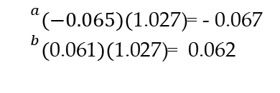
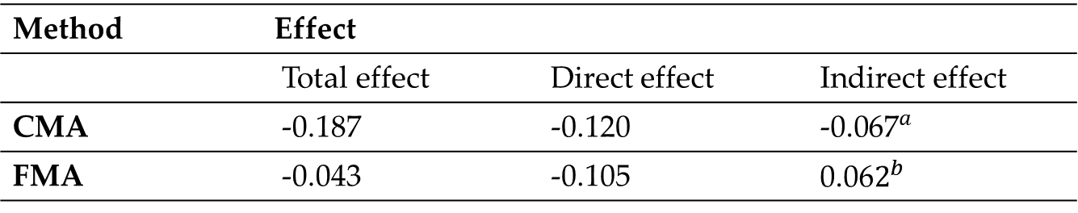
Method Effect
 | Total effect | Direct effect | Indirect effect
CMA | -0.187 | -0.120 | ${\text{−0.067}}^{a}$
FMA | -0.043 | -0.105 | ${\text{0.06}2}^{b}$
${}^{a}(−0.065)(\text{1.027)}$= - 0.067
${}^{b}(\text{0.061})\text{(}\text{1.027)}$= 0.062
Effect | Method | 95% CI (lower bound) | 95% CI (upper bound) | z(t) | p-value
Total | CMA | -0.194 | -0.179 | -46.75 | <0.01
 | FMA | -0.057 | -0.029 | -6.143 | <0.01
Direct | CMA | -0.128 | -0.112 | -30.0 | <0.01
 | FMA | -0.119 | -0.091 | -15.0 | <0.01
Indirect | CMA
 | FMA

Slide 9
 | temp | rain | wind speed | humidity | sun hour | solar radiation | snow | cloud
p-value | 0.000 | 0.019 | 0.000 | 0.000 | 0.000 | 0.000 | 0.000 | 0.000

